Slide 1



CIT 596 MODULE 12.4
NP-completeness
Sampath Kannan

Slide 2


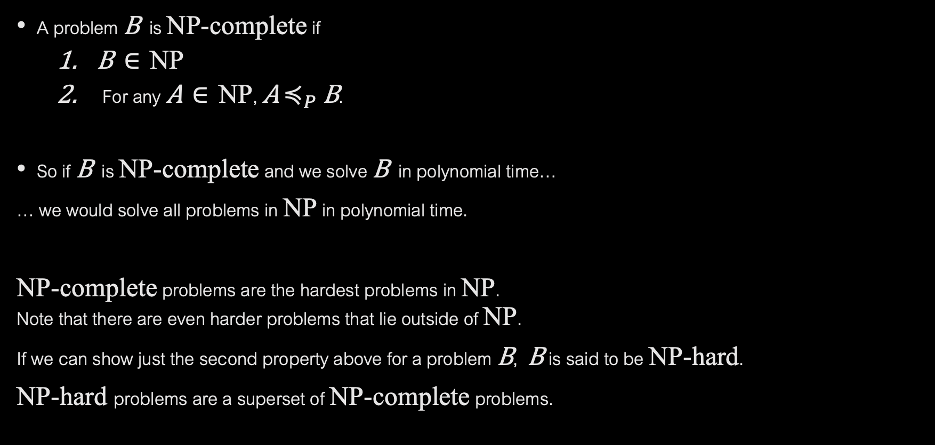
NP-COMPLETENESS
A problem B is NP-complete if
B $∈$ NP
For any A $∈$ NP, A $≼_{P}$ B.
So if B is NP-complete and we solve B in polynomial time…
… we would solve all problems in NP in polynomial time.
NP-complete problems are the hardest problems in NP. Note that there are even harder problems that lie outside of NP.
If we can show just the second property above for a problem B, B is said to be NP-hard.
NP-hard problems are a superset of NP-complete problems.

Slide 3
PROVING NP-COMPLETENESS
Proving that problem B is NP-complete seems difficult…
We need to show a polynomial time reduction from every problem in NP to B.
There are infinitely many problems in NP!
Proving that the first problem is NP-complete is challenging, but luckily, it’s been done for us. We will see the Cook-Levin theorem that does it.
Cook-Levin theorem proves that circuit-satisfiability is NP-complete.
Once we have this proof, it is not as difficult to prove other problems NP-complete.

Slide 4

GIVEN ONE NP-COMPLETE PROBLEM
Suppose we already know that problem A is NP-complete.
This means that A $∈$ NP and all problems in NP reduce to A.
Now suppose we want to prove that problem B is NP-complete.
We have to show that B $∈$ NP, which is usually not hard.
We then have to reduce all problems in NP to B.
Suppose instead that we just reduce A to B.
For any problem C $∈$ NP, we already know C reduces to A (since A is NP-complete).
So C reduces to A, which reduces to B.
If we can show that polynomial time reductions are transitive, which means
if C reduces to A and A reduces to B then C reduces to B,
Then we would have shown that all problems in NP reduce to B !

Slide 5
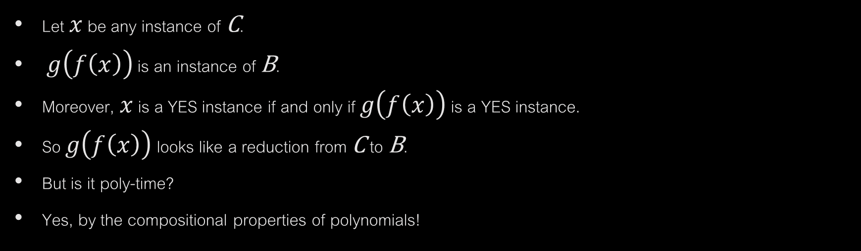


TRANSITIVITY OF REDUCTIONS
YES instances of C
YES instances of A
YES instances of B
$$f$$
$$g$$
NO instances of C
NO instances of A
NO instances of B
Let $x$ be any instance of C.
$g\left(f\left(x\right)\right)$ is an instance of B.
Moreover, $x$ is a YES instance if and only if $g\left(f\left(x\right)\right)$ is a YES instance.
So $g\left(f\left(x\right)\right)$ looks like a reduction from C to B.
But is it poly-time?
Yes, by the compositional properties of polynomials!

Slide 6
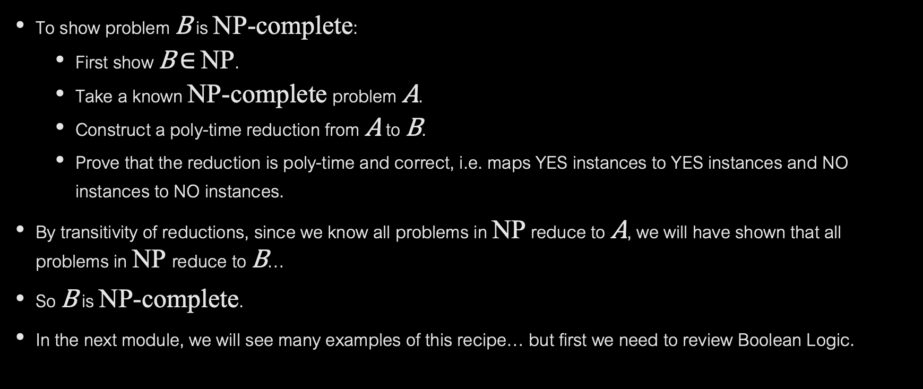
RECIPE FOR PROVING A PROBLEM NP-COMPLETE
To show problem B is NP-complete:
First show B $∈$ NP.
Take a known NP-complete problem A.
Construct a poly-time reduction from A to B.
Prove that the reduction is poly-time and correct, i.e. maps YES instances to YES instances and NO instances to NO instances.
By transitivity of reductions, since we know all problems in NP reduce to A, we will have shown that all problems in NP reduce to B…
So B is NP-complete.
In the next module, we will see many examples of this recipe… but first we need to review Boolean Logic.

Slide 7

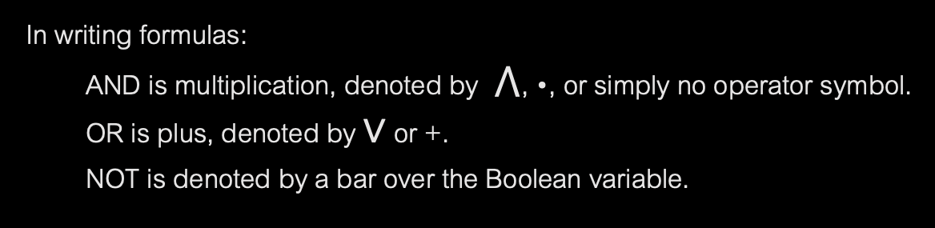





BOOLEAN LOGIC NOTATION
As we know from CIT 593, circuits lie at the heart of a computer.
We will think of Boolean circuits consisting of AND, OR, and NOT gates.
$$x∧y$$
$$x∨y$$
$$\overline{x}$$
$$x y$$
$$x y$$
$$x$$
AND OR NOT gates
In writing formulas:
AND is multiplication, denoted by $⋀$, •, or simply no operator symbol.
OR is plus, denoted by $∨$ or +.
NOT is denoted by a bar over the Boolean variable.

Slide 8
BOOLEAN CIRCUIT
Directed acyclic graph
Types of nodes: input nodes, AND nodes, OR nodes, NOT nodes
Input nodes have 0 in-degree.
AND nodes as well as OR nodes have in-degree 2.
NOT nodes have in-degree 1.
One special node designated as output node with out-degree 1.
The value of the circuit is the value on the out-edge of the output node.

Slide 9
EXAMPLE OF A BOOLEAN CIRCUIT
Q
0
Q
1
0
0
0 1 0
1 0 0
A B C
1 1 0
0 0 0
A B C

Slide 10
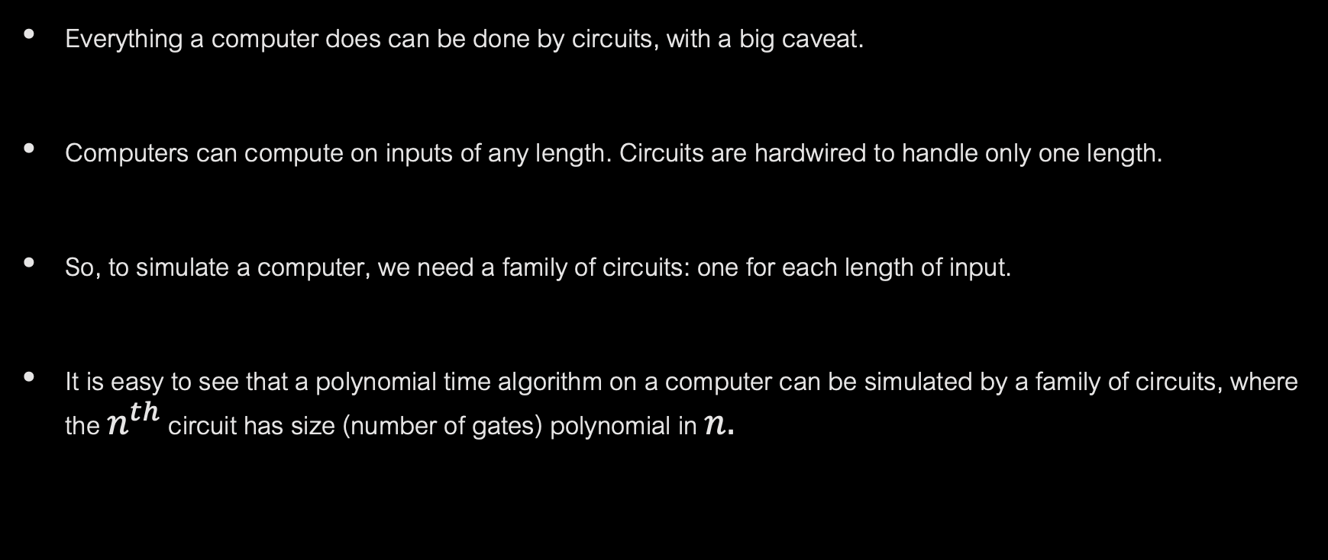
CIRCUITS AS COMPUTERS
Everything a computer does can be done by circuits, with a big caveat.
Computers can compute on inputs of any length. Circuits are hardwired to handle only one length.
So, to simulate a computer, we need a family of circuits: one for each length of input.
It is easy to see that a polynomial time algorithm on a computer can be simulated by a family of circuits, where the $n^{th}$ circuit has size (number of gates) polynomial in $n.$

Slide 11
CIRCUIT VALUE AND CIRCUIT SATISFIABILITY
In the circuit value problem, we are given a circuit and Boolean values for the input nodes.
We need to compute the value of the circuit.
This problem can be easily solved in polynomial time.
Simply find the value of each node in topological sort order (remember we have a DAG)…
...until we get the value of the output node.
Circuit Satisfiability Problem:
Here the inputs are Boolean variables (not values).
We want to know if there exist values for the variables, so that the circuit value evaluates to 1.
This is the famous Circuit Satisfiability Problem that we will see is NP-complete.

